Slide 1
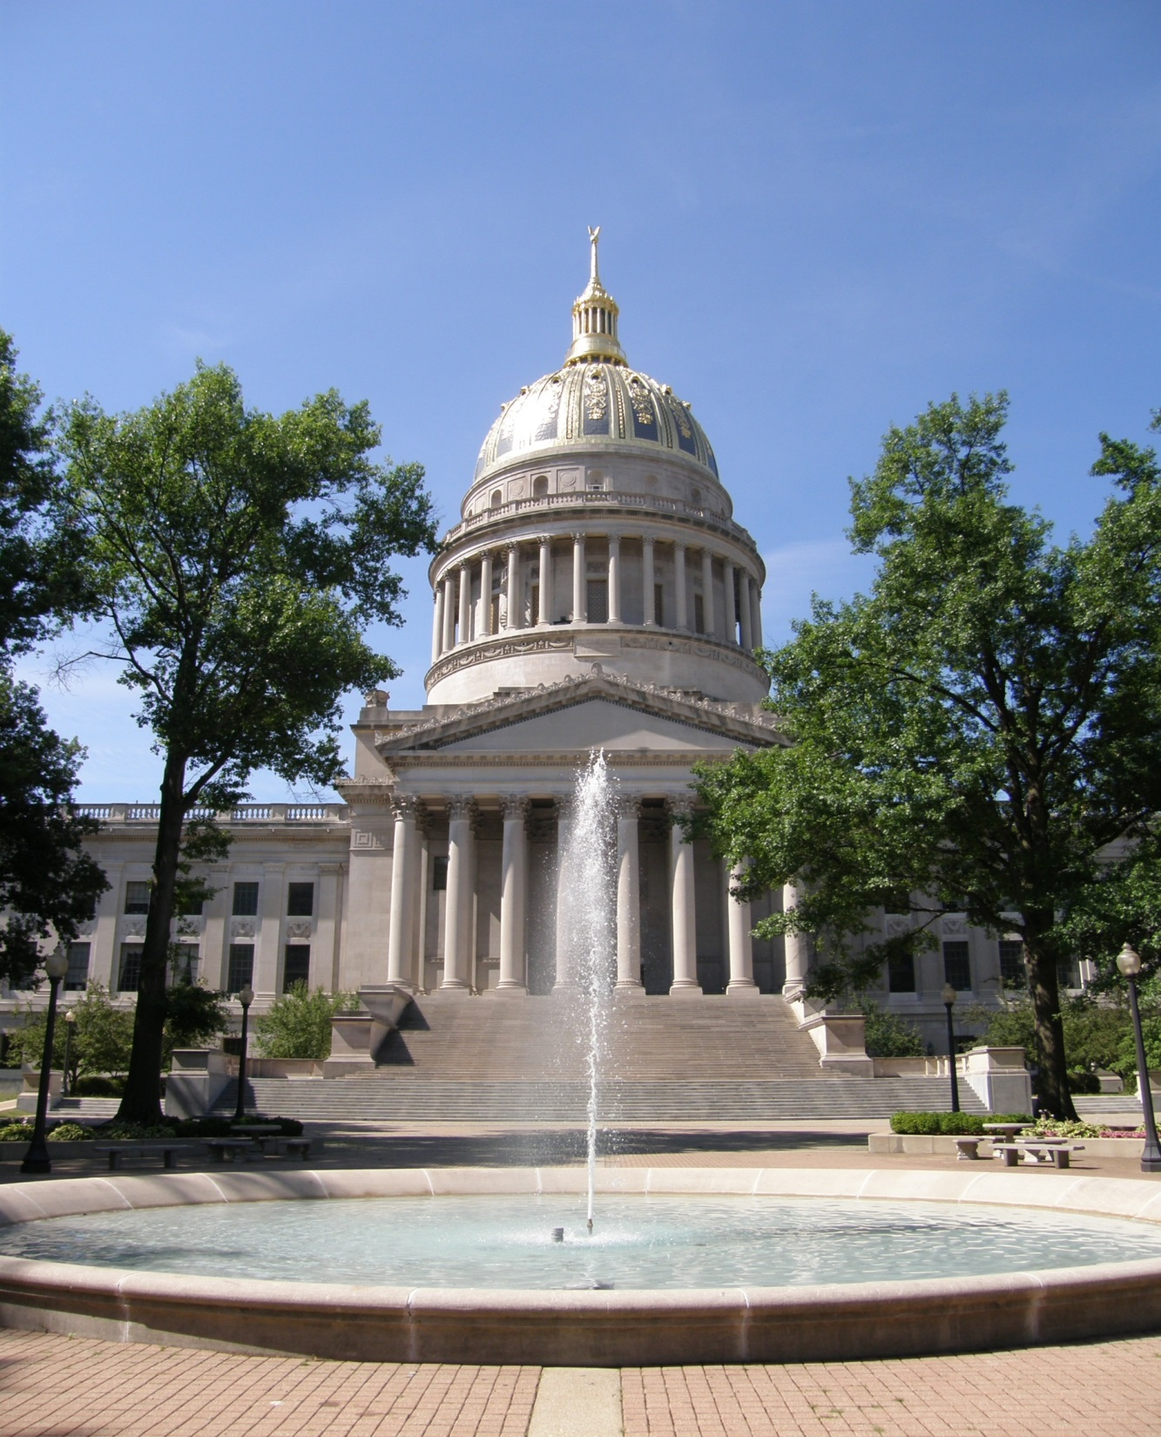
Department of Administration
House Finance
Fiscal Year 2022 Budget
Allan McVey
Cabinet Secretary

Slide 2
Department of Administration Agencies
Office of the Secretary
Aviation
Board of Risk and Insurance Management
Consolidated Public Retirement Board
Ethics Commission
Equal Employment Opportunity Office
Finance Division
Fleet Management
General Services Division
Grievance Board
Office of Technology / Information Services and Communications Division
Personnel Division
Prosecuting Attorney’s Institute
Public Defender Services
Public Employees Insurance (and Retiree Health Benefits Trust Fund)
Purchasing Division
Real Estate Division
Surplus Property

Slide 3
Budget Challenges
Public Employees Insurance Agency
Public Defender Services
Office of Technology-Cyber Security Initiatives
General Services Division
Repairs, renovations, and preventative maintenance of the State Capitol Complex and implementation of long-range Master Plan
Maintenance and upkeep of State-owned buildings throughout the State

Slide 4
FY 2021 Supplemental Appropriation Request
General Revenue
Public Defender Services
$20,000,000

Slide 5
Revenue Sources
 | FY 2020 Actual | FY 2021 Budget | FY 2022 Request
General | 107,466,875 | 105,046,116 | 105,046,116
Special | 176,779,797 | 174,949,144 | 174,649,144
Lottery | 9,993,703 | 10,000,000 | 10,000,000
Other* | 805,515,521 | 884,075,999 | 881,073,261
 | 1,099,755,896 | 1,174,071,259 | 1,170,768,521
*Excludes retirement plans, see actual expense detail for plans on “Other (Non-appropriated) Special Revenue Agencies” slide, page 10.

Slide 6
General Revenue Agencies
Dept | Department Name | FY 2020 Actual | FY 2021 Budget | FY 2022 Request
0201 | SECRETARY OF ADMINISTRATION | 15,531,390 | 15,740,252 | 15,740,252
0209 | FINANCE DIVISION | 867,539 | 753,000 | 753,000
0211 | GENERAL SERVICES DIVISION | 16,192,154 | 27,769,219 | 27,769,219
0213 | PURCHASING DIVISION | 764,042 | 1,064,477 | 1,064,477
0215 | TRAVEL MANAGEMENT (AVIATION) | 1,030,832 | 1,260,842 | 1,260,842
0217 | COMMISSION ON UNIFORM STATE LAWS | 40,061 | 45,550 | 45,550
0219 | PUBLIC EMPLOYEES GRIEVANCE BOARD | 1,180,328 | 1,124,712 | 1,124,712
0220 | ETHICS COMMISSION | 703,924 | 719,844 | 719,844
0221 | PUBLIC DEFENDER SERVICES | 49,065,059 | 34,485,646 | 34,485,646
0225 | PUBLIC EMPLOYEES INSURANCE AGENCY | 21,000,000 | 21,000,000 | 21,000,000
0224 | COMMODITIES AND SERVICES FROM THE HANDICAPPED | 140 | 4,055 | 4,055
0228 | PROSECUTING ATTORNEYS INSTITUTE | 298,232 | 246,653 | 246,653
0233 | REAL ESTATE DIVISION | 793,174 | 831,866 | 831,866
Grand Total |  | 107,466,875 | 105,046,116 | 105,046,116

Slide 7
Special Revenue Appropriated Agencies
Dept. | Department Name | FY 2020 Actual | FY 2021 Budget | FY 2022 Request
0201 | SECRETARY OF ADMINISTRATION | 129,288,069 | 113,028,000 | 113,028,000
0209 | FINANCE DIVISION | 993,651 | 2,000,000 | 2,000,000
0210 | INFORMATION SERVICES AND COMMUNICATIONS | 28,571,620 | 39,321,583 | 39,321,583
0213 | PURCHASING DIVISION | 1,451,750 | 2,142,050 | 2,142,050
0215 | TRAVEL MANAGEMENT - AVIATION | 1,053,989 | 1,327,237 | 1,027,237
0216 | FLEET MANAGEMENT | 9,489,543 | 9,705,759 | 9,705,759
0222 | DIVISION OF PERSONNEL | 5,291,582 | 6,159,914 | 6,159,914
0228 | PROSECUTING ATTORNEYS INSTITUTE | 195,466 | 554,814 | 554,814
0231 | OFFICE OF TECHNOLOGY | 444.128 | 709,787 | 709,787
Grand Total |  | 176,779,797 | 174,949,144 | 174,649,144

Slide 8
Lottery Funds
Dept. | Department Name | FY 2020 Actual | FY 2021 Budget | FY 2022 Request
0211 | GENERAL SERVICES DIVISION | $ 9,993,703 | $10,000,000 | $10,000,000

Slide 9
Other (Non-appropriated) Special Revenue Agencies
Department Name | FY 2020 Actual Expenses
TEACHERS RETIREMENT SYSTEM | 1,192,851,910
PUBLIC EMPLOYEES INSURANCE AGENCY | 636,502,520
PUBLIC EMPLOYEES RETIREMENT SYSTEM | 437,261,887
RETIREE HEALTH BENEFIT TRUST FUND | 214,495,918
BOARD OF RISK AND INSURANCE MANAGEMENT | 97,969,989
GENERAL SERVICES DIVISION | 35,529,815
TEACHERS DEFINED CONTRIBUTION PLAN | 24,282,713
CONSOLIDATED PUBLIC RETIREMENT BOARD | 9,765,816
INFORMATION SERVICES AND COMMUNICATIONS | 20,264,542
DEPUTY SHERIFF RETIREMENT SYSTEM | 12,228,290
JUDGES RETIREMENT SYSTEM | 4,346,545
SURPLUS PROPERTY | 1,681,730
FINANCE DIVISION | 2,634,478
EMERGENCY MEDICAL SERVICES RETIREMENT SYSTEM | 3,980,351
REAL ESTATE DIVISION | 565,662
PURCHASING DIVISION | 452,957
MUNICIPAL POLICE OFFICERS AND FIREFIGHTERS RETIREMENT SYSTEM | 245,223
WV PUBLIC SAFETY DEATH DIS & RETIREMENT SYS PLAN A | 43,947,909
WV STATE POLICE RETIREMENT SYSTEM PLAN B | 2,361,487
PUBLIC DEFENDER SERVICES | 57,850
PROSECUTING ATTORNEYS INSTITUTE | 84,048
ETHICS COMMISSION | 6,111
GRAND TOTAL | 2,741,517,755

